Slide 1
Advanced Android Application Development
3b – Activity Lifecycle and Data, Content Providers and Loaders

Slide 2
Contents
Why Content Providers Matter
Create a Content Provider
Determine URIs
Update Contract
URIMatcher
Register the Content Provider
Code the Content Provider
Cursor Loader

Slide 3
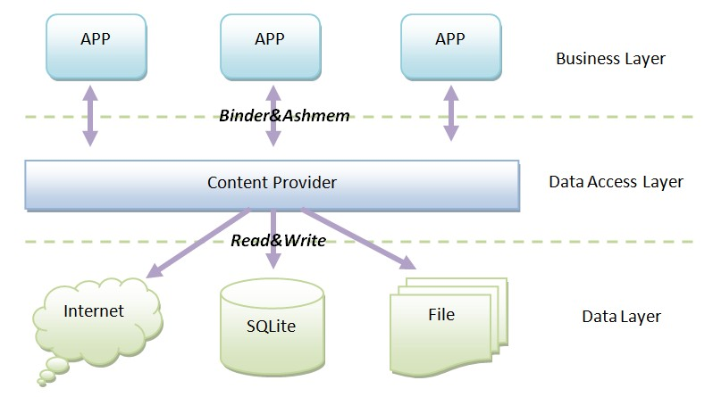
Why Content Providers Matter
http://developer.android.com/guide/topics/providers/content-providers.html

Slide 4
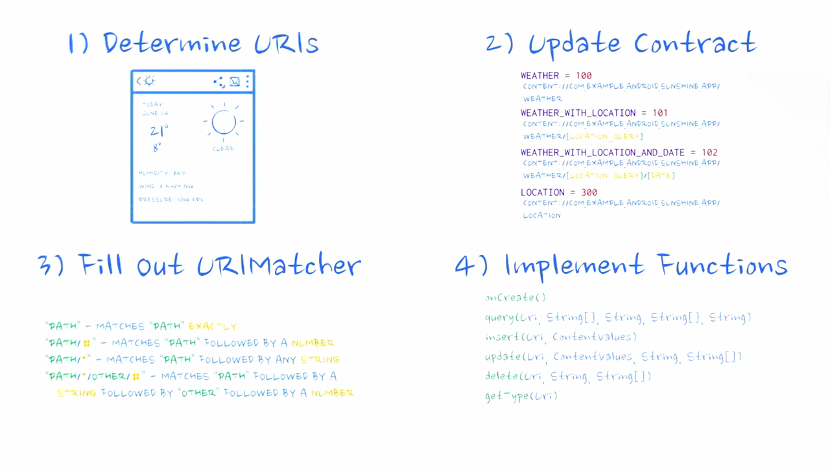
Create a Content Provider

Slide 5
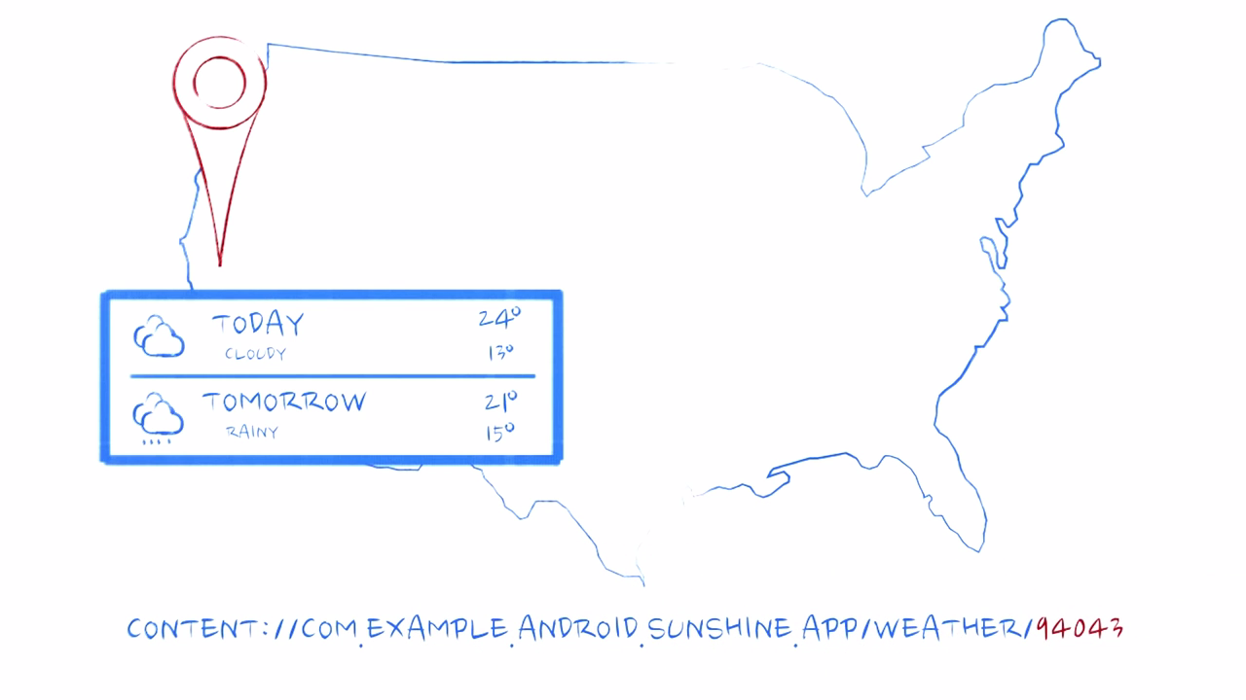
Determine URIs

Slide 6
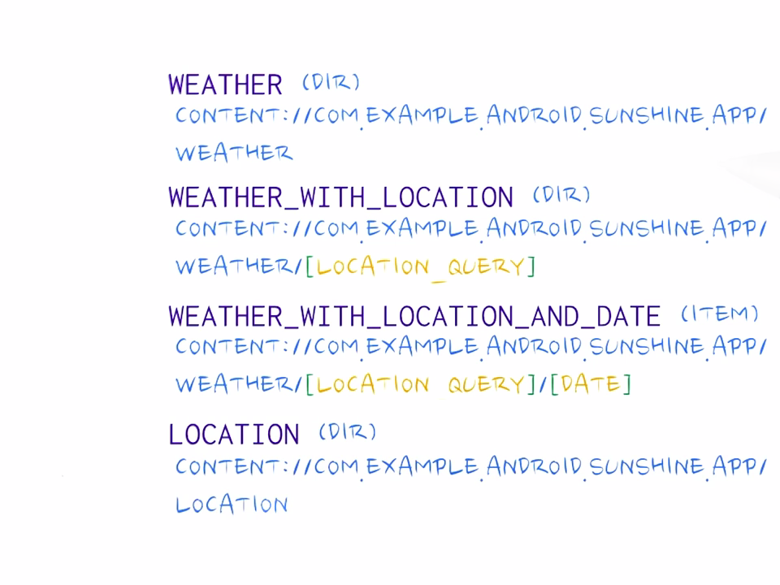
Determine URIs

Slide 7
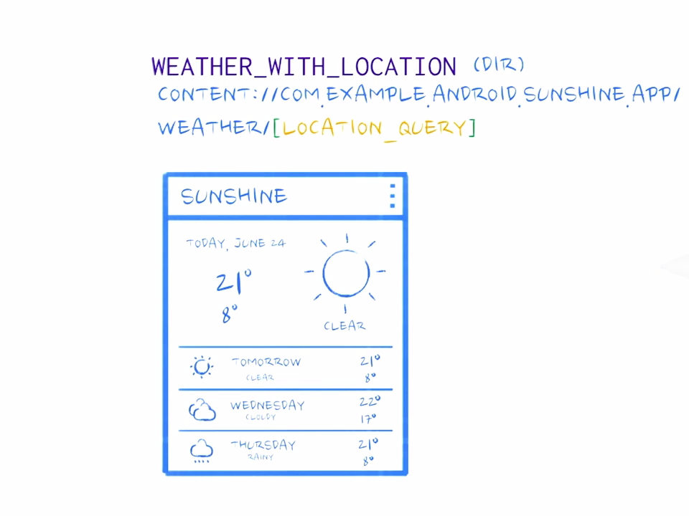
Determine URIs

Slide 8
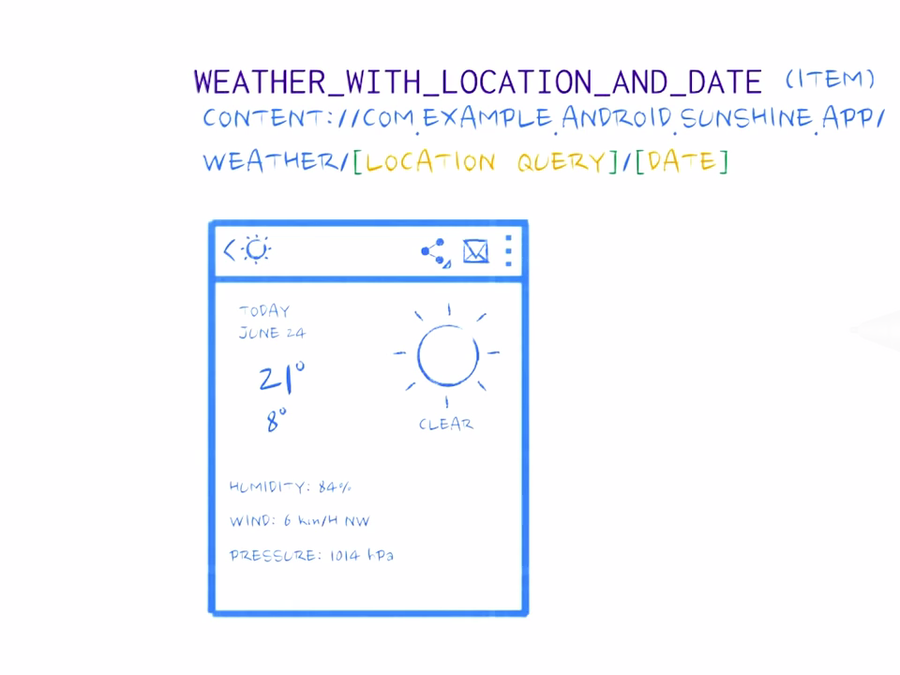
Determine URIs

Slide 9
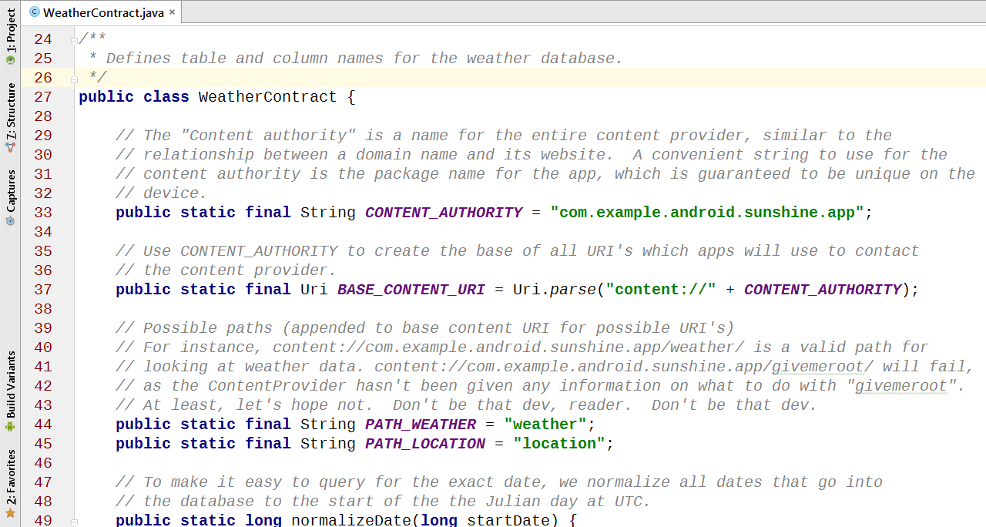
Update Contract – Content Authority

Slide 10
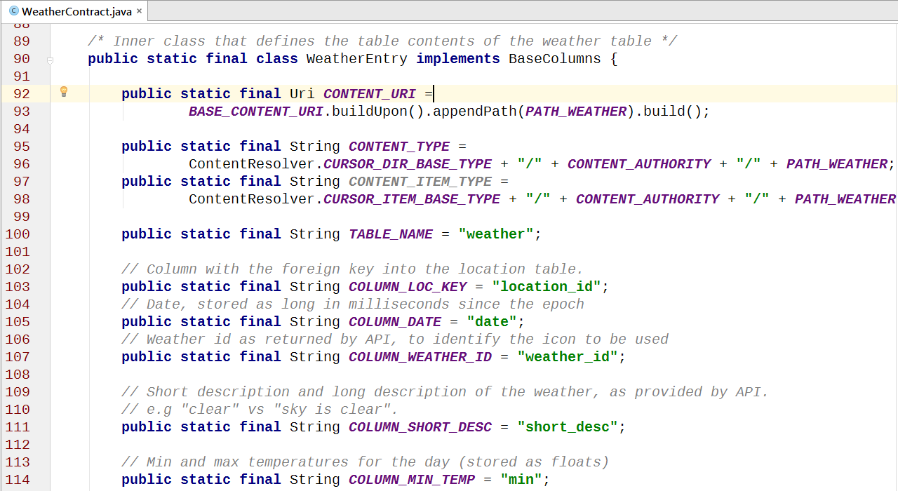
Update Contract – Content URI

Slide 11
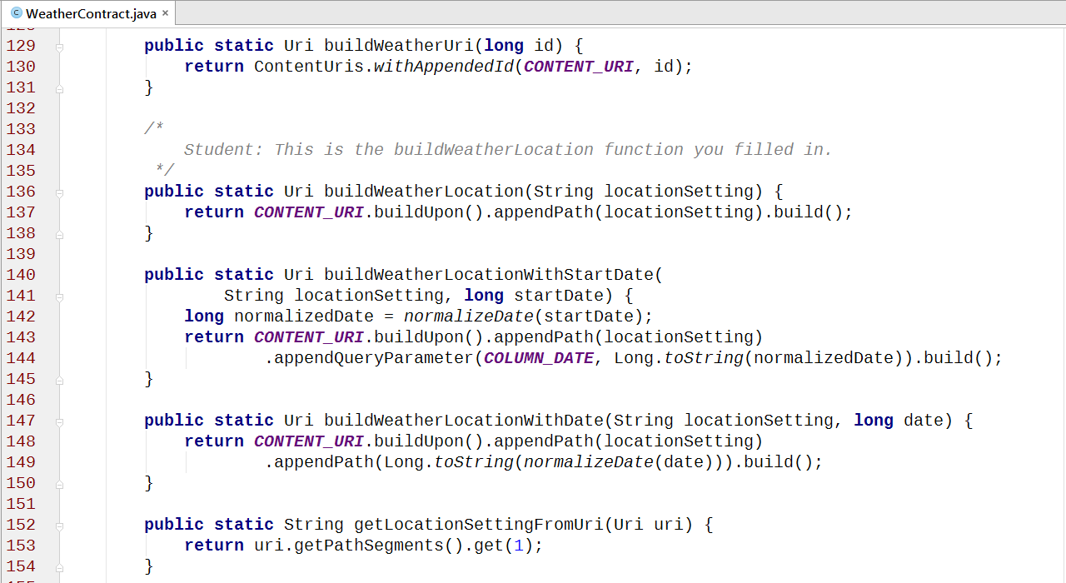
Update Contract – URI Builders

Slide 12
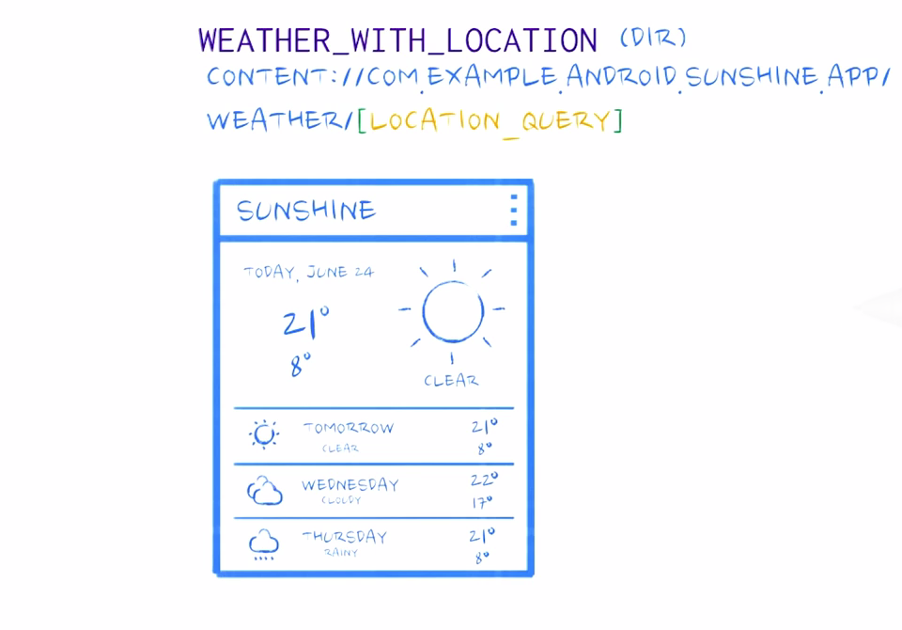
Update Contract – URI Builders

Slide 13
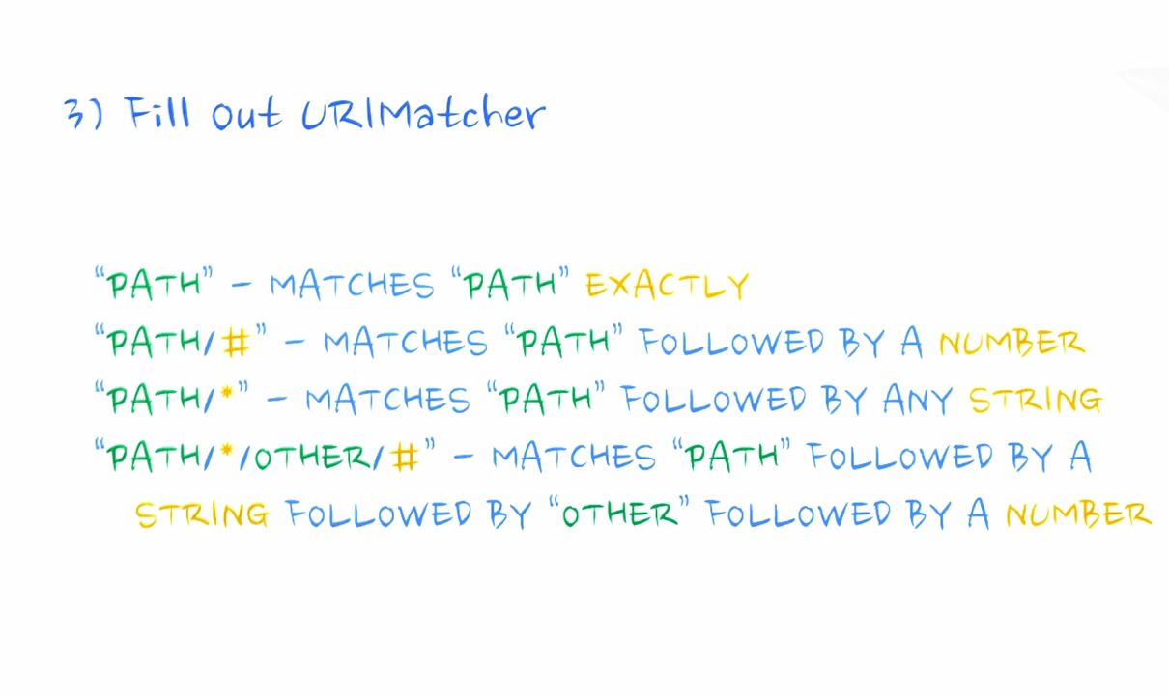
URIMatcher

Slide 14
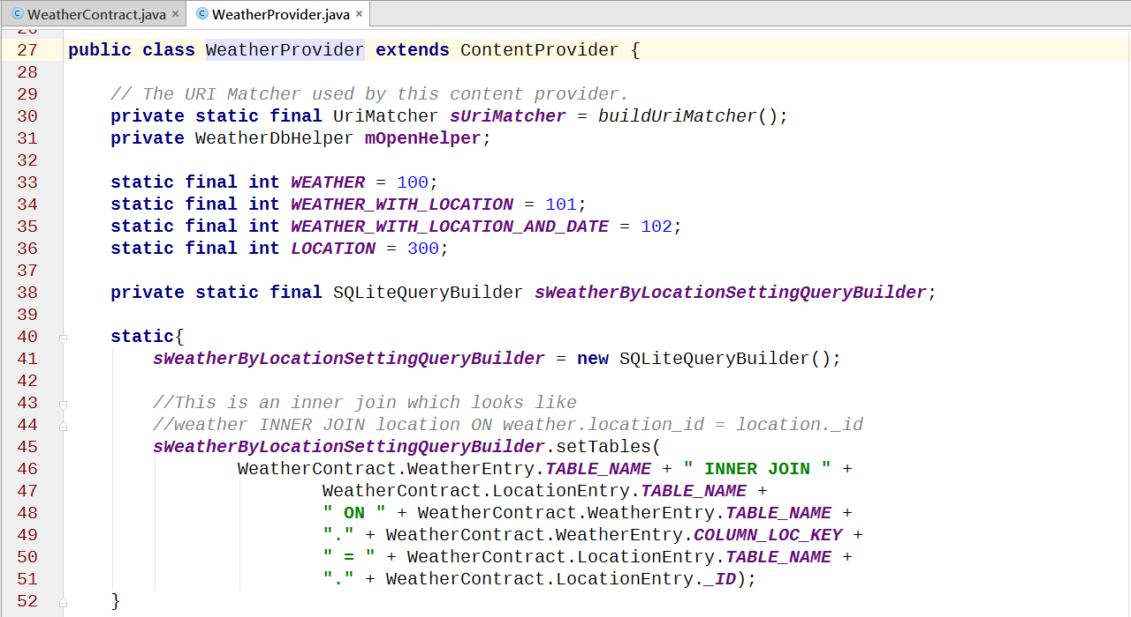
URIMatcher

Slide 15
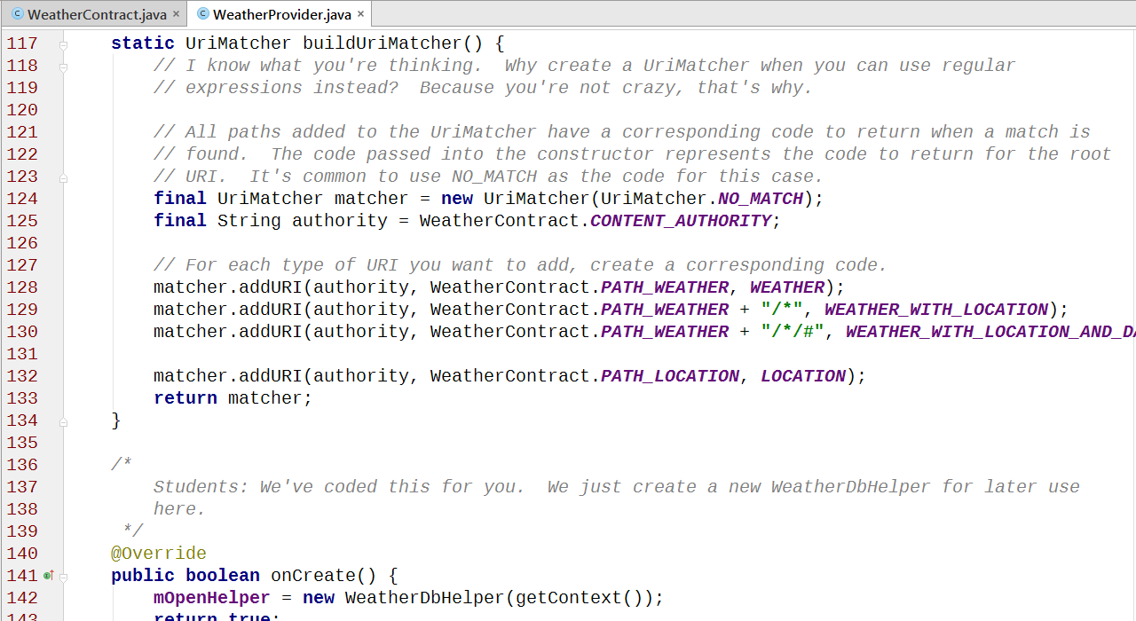
Write the URIMatcher

Slide 16
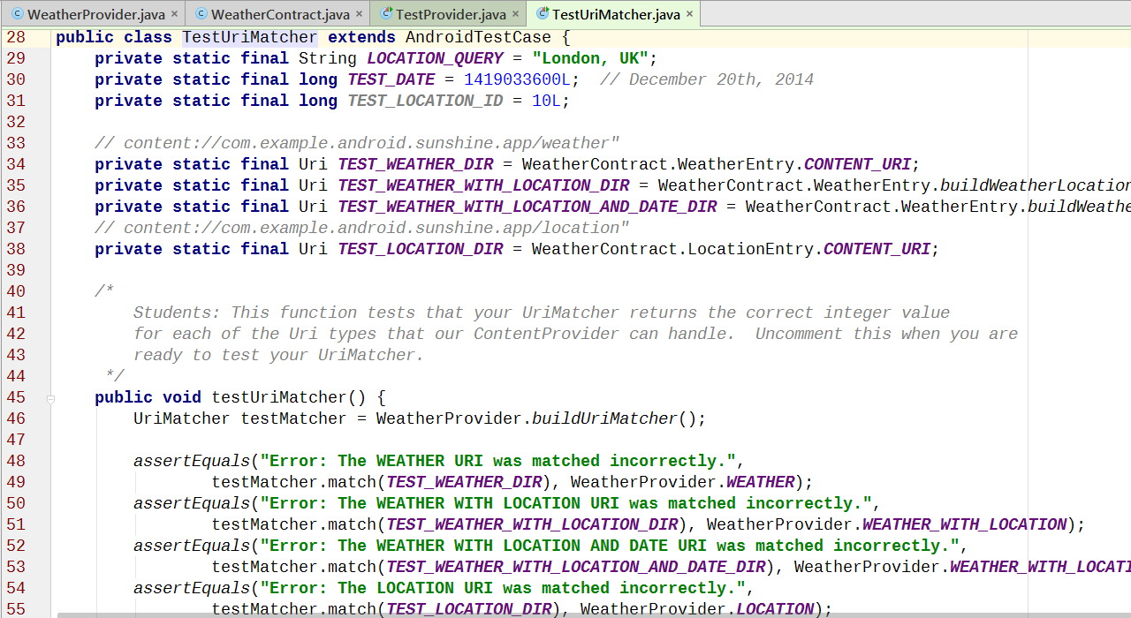
Test the URIMatcher

Slide 17
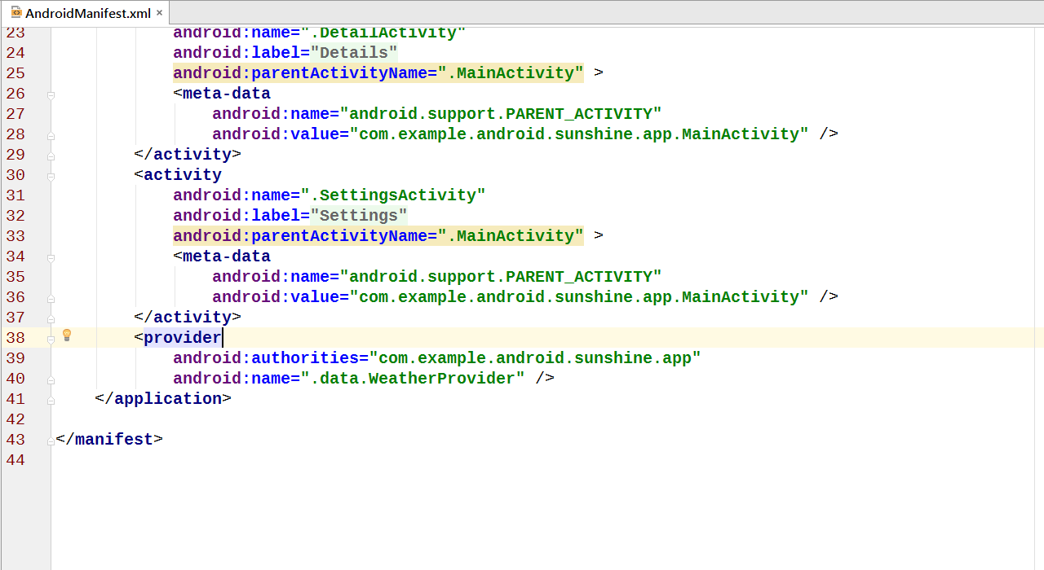
Register the Content Provider

Slide 18
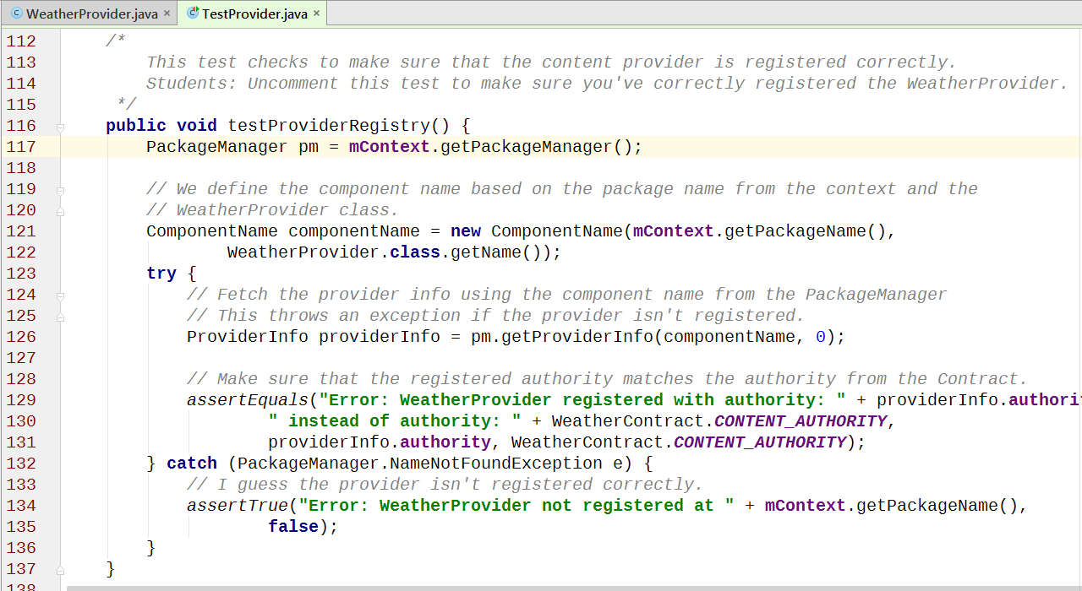
Register the Content Provider

Slide 19
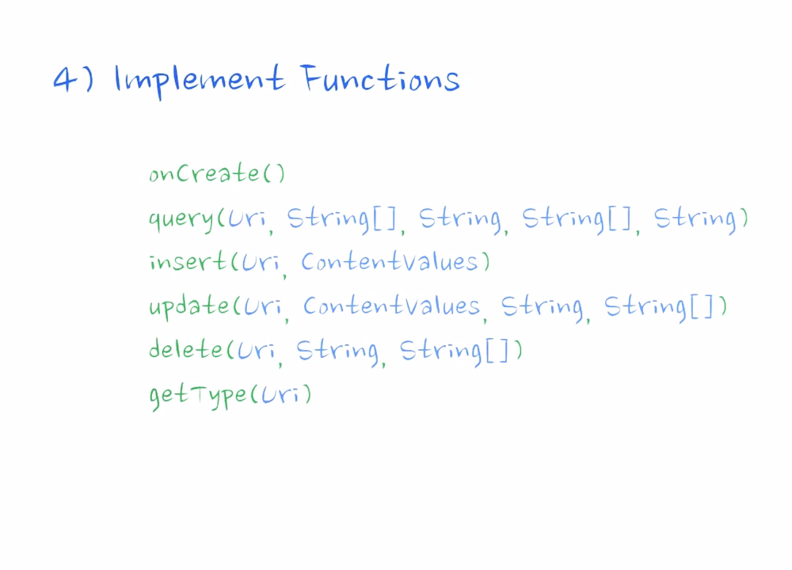
Code the Content Provider

Slide 20
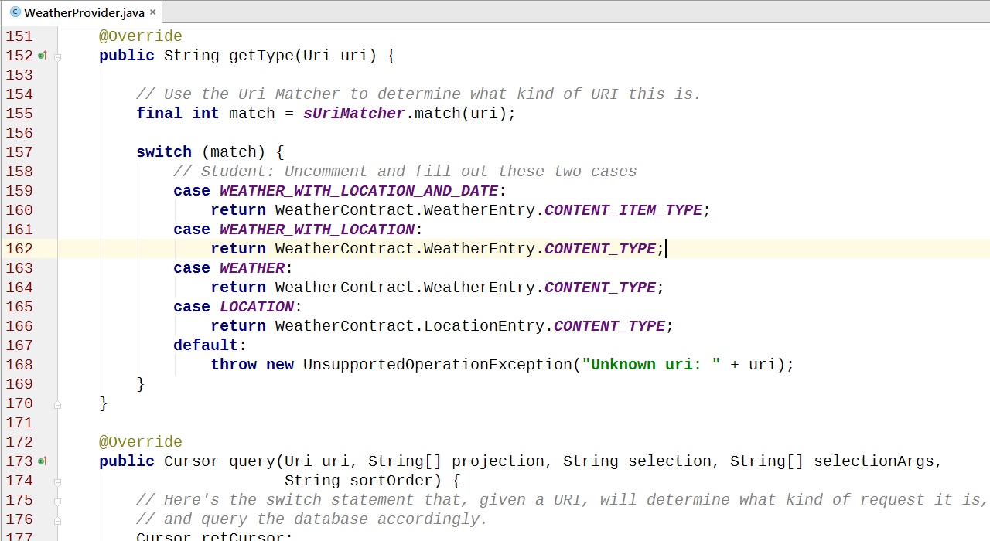
Code the Content Provider – getType()

Slide 21
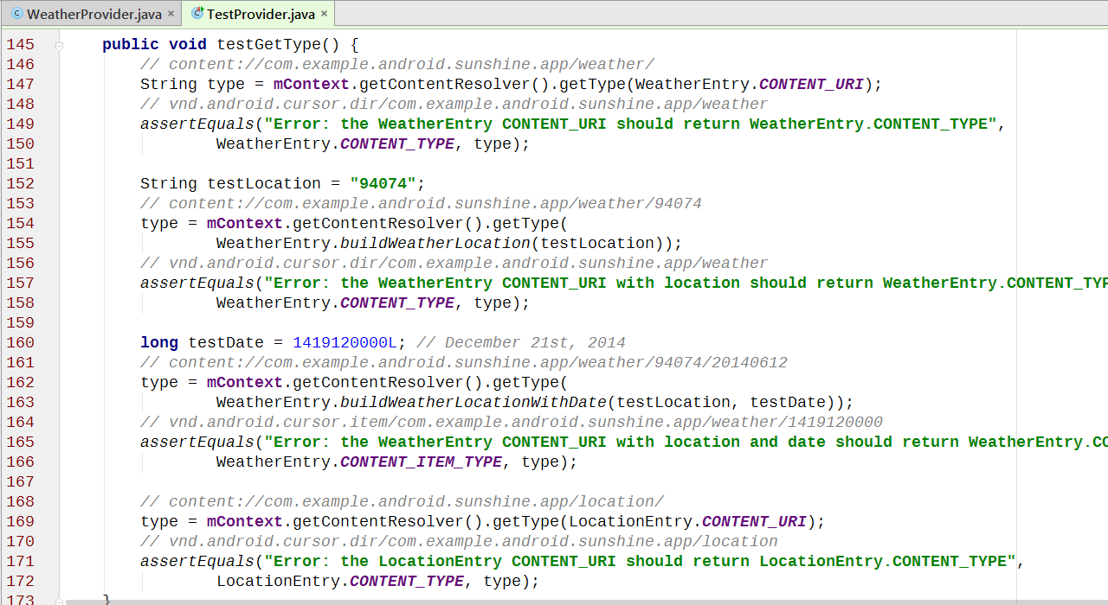
Test getType()

Slide 22
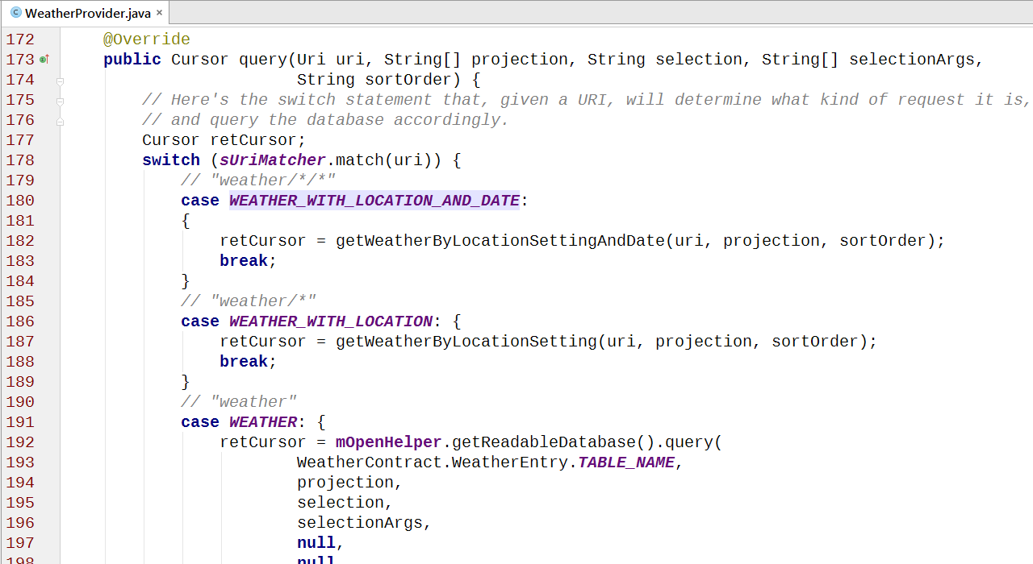
Code the Content Provider – query()

Slide 23
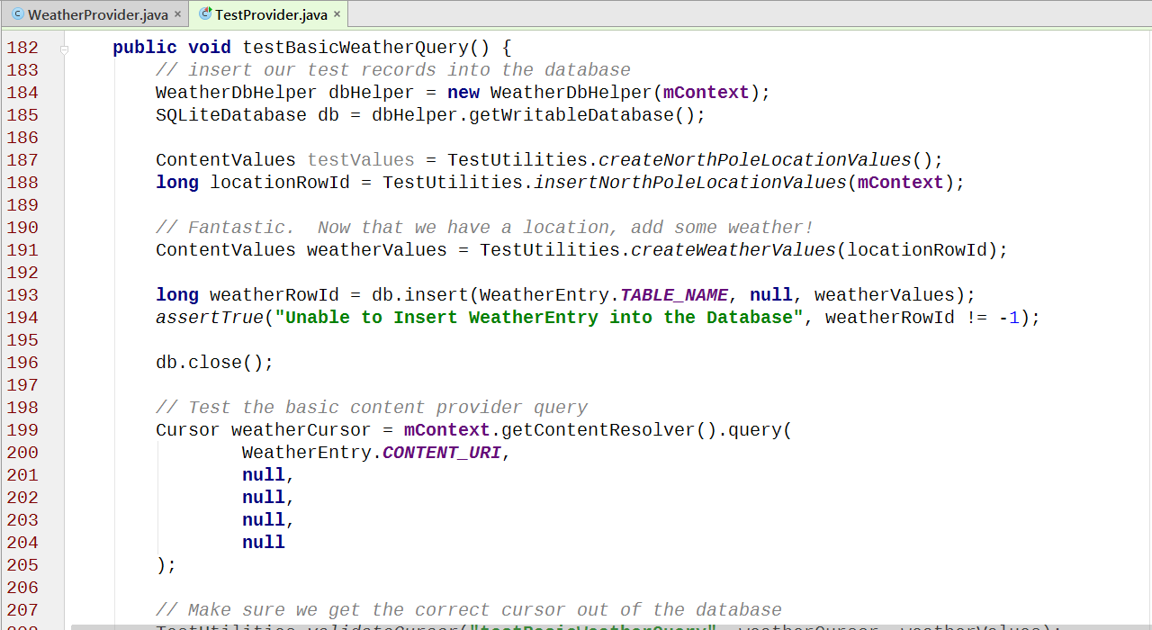
Test the Content Provider – query()

Slide 24
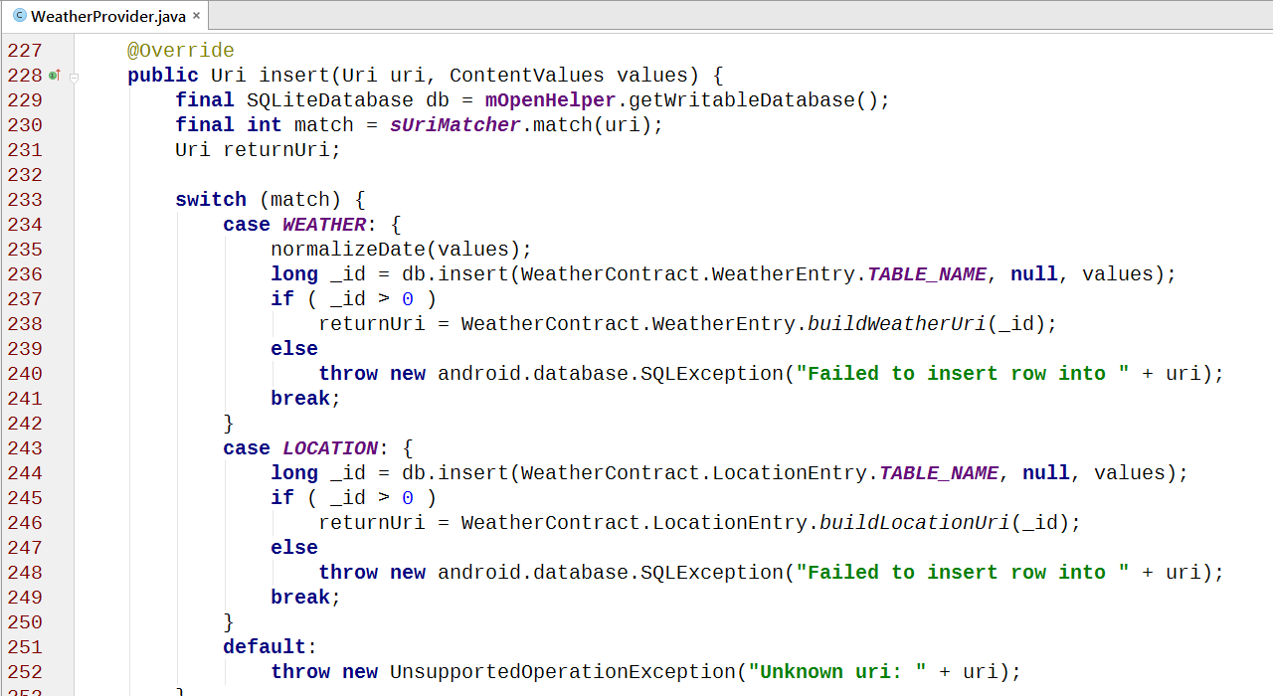
Code the Content Provider – insert()

Slide 25
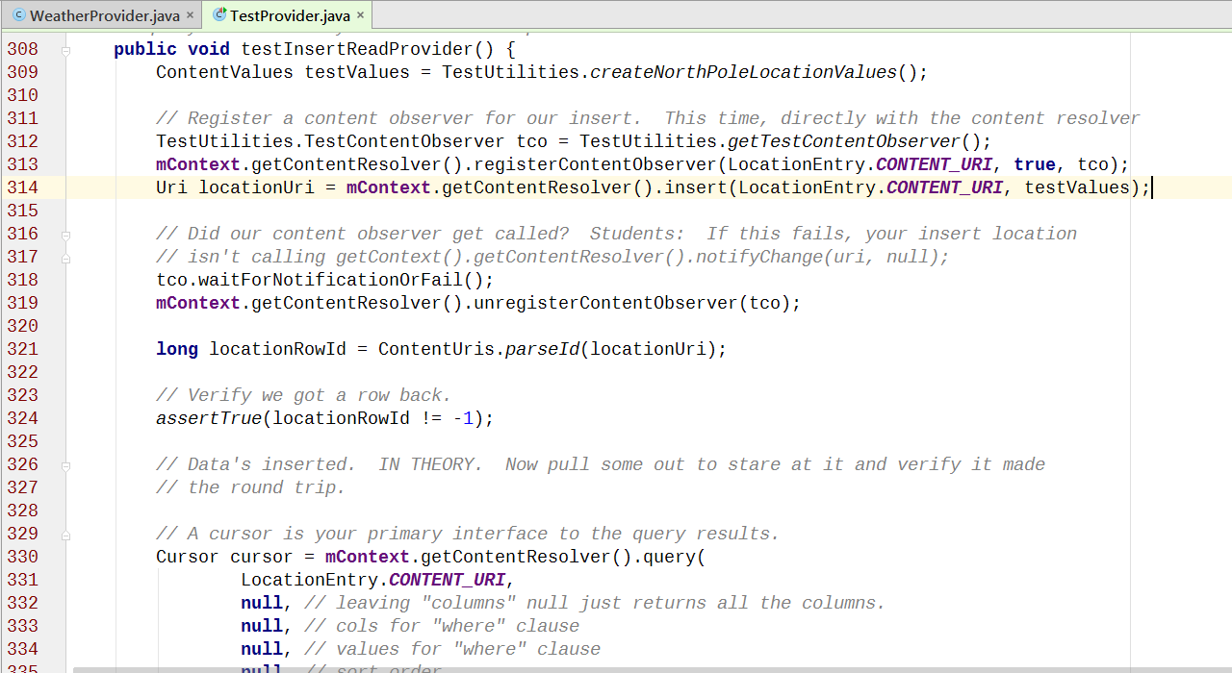
Test the Content Provider – insert()

Slide 26
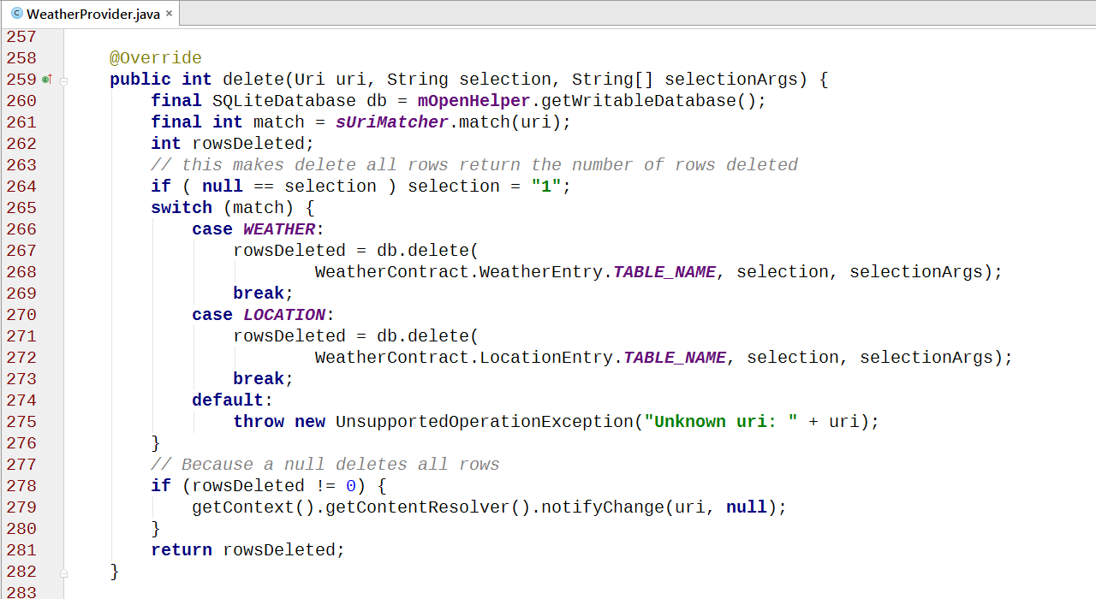
Code the Content Provider – delete()

Slide 27
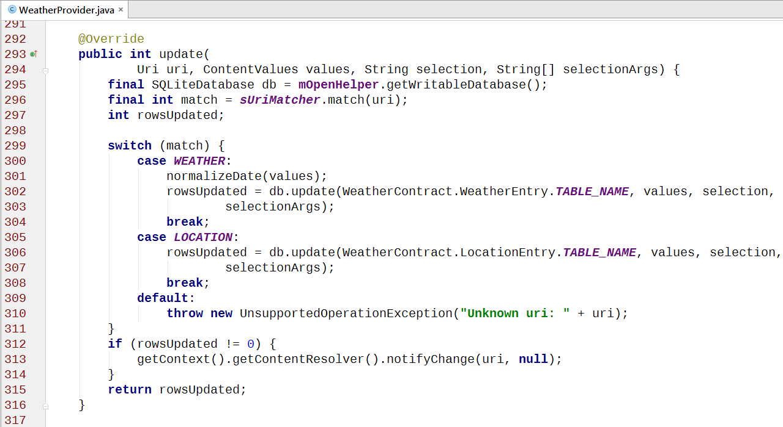
Code the Content Provider – update()

Slide 28
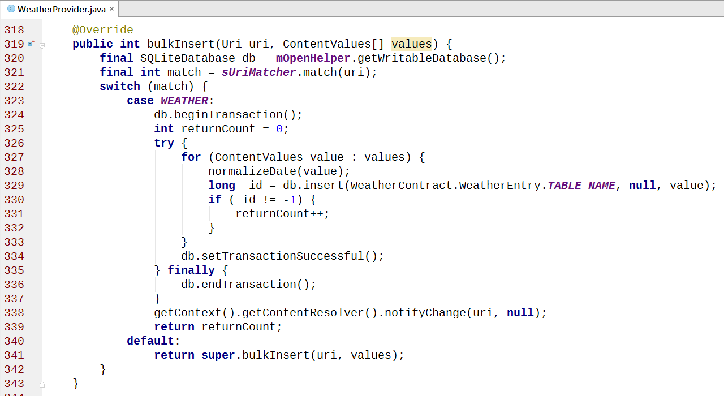
bulkInsert()

Slide 29
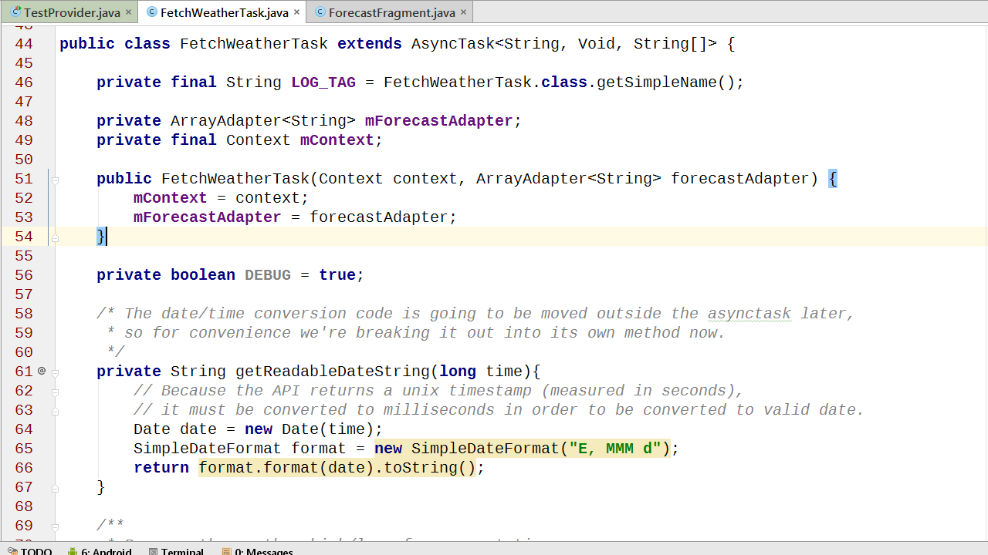
Refactoring FetchWeatherTask

